Slide 1
IICT Construction Site Management System

Slide 2
Task :
Requirement Analysis
Construction site management refers to the process of planning, organizing, and supervising the activities carried out on a construction site to ensure that the project is completed on time, within budget, and in compliance with applicable regulations and safety standards.
Managing a construction site manually can be a daunting and challenging task. There are several problems that can arise when trying to handle a construction site management system manually, including
__Lack of real-time data
__Safety concerns
__Inefficient communication
__Difficulty in managing resources

Slide 3
A Construction Site Database Management System can be highly useful in managing construction site activities, as it can help to streamline processes, improve communication, and increase overall efficiency.
The whole process(storyline):
- (1)Receiving contract
- (2)Planning: This involves developing a project plan that outlines the scope of the project, the timeline, the budget, and the resources required.
- (3)Site Preparation: Once the project plan is in place, the site preparation process begins. This involves clearing the site, setting up the construction site office, installing temporary facilities .
-(4) Procurement: The procurement process involves identifying and purchasing the necessary construction materials, equipment, and supplies.
-(5) Construction Activities: With the site prepared and resources in place, construction activities can begin.
-(6) Quality Control: This involves regular inspections and testing to verify that the work meets the required standards and specifications.
-(7) Project Management: This includes managing the project team, coordinating activities, communicating with stakeholders, and monitoring progress against the project plan.

Slide 4
Inputs of a construction site database:
Raw Materials
Stocks
Order Jobs
Bill
Received receipt
Attendance
Budget
8. Schedule

Slide 5
Things To Do in a Construction Site:
Collect Materials
Collect Labor
Manager > Site Manager[Recruiting]
Financial Management
Site Select & preparing
Salary
Categorizing Work
Schedule Management

Slide 6
Materials:
Machine :
MS Rod
Fresh cement
Stone Chips
Brick
Tiles
Stair Railing
Marbel
Door
Sanitary
Electrical instrument
Miner
Vibrator Machine
Vibrator Nozzle
Shovel Tools
Roof
Motor

Slide 7
People who are connected to a construction site management system and who can get access to our database :
Head office:
HR Md
GM
DGBM
AGM
Field worker :
Manager
PM
PG
Cite Engineer
Supervisor
Foreman of different sectors : - civil
- Sanitary
- Electrical

Slide 8
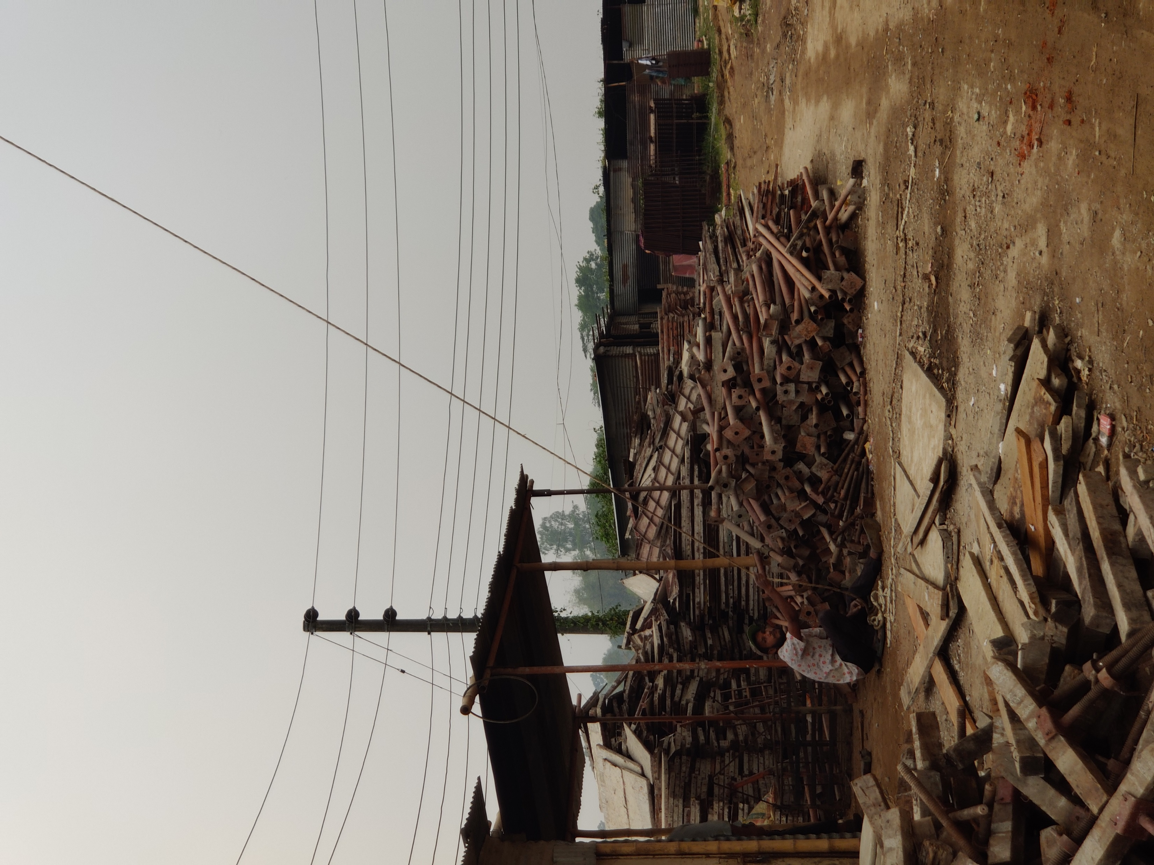
Some of our construction site pictures :

Slide 9
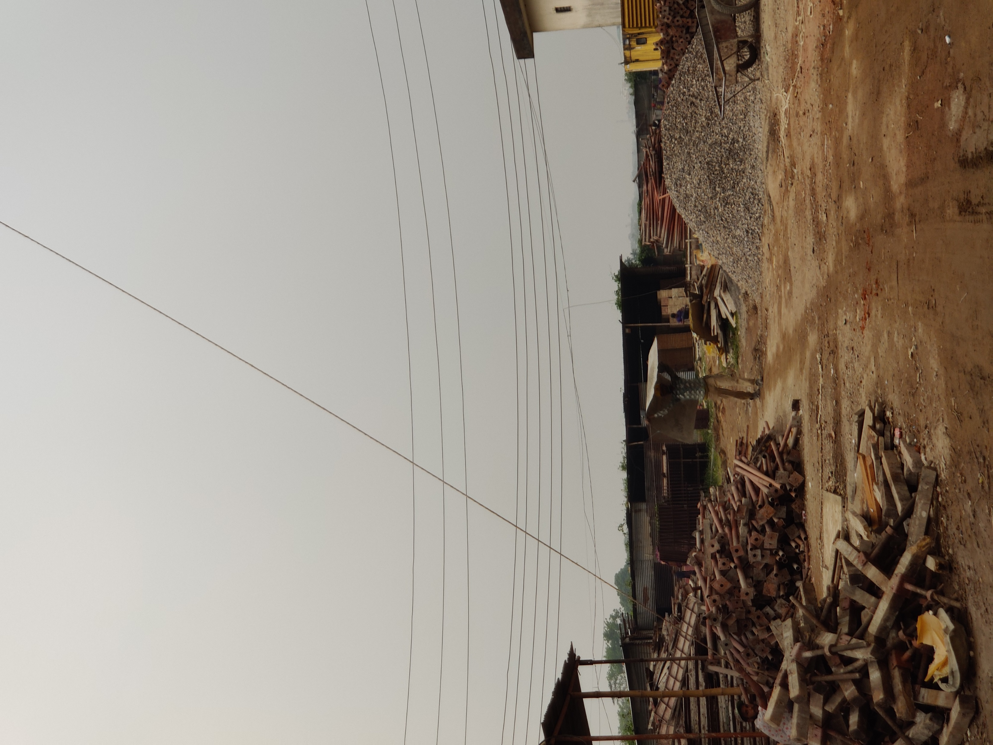

Slide 10
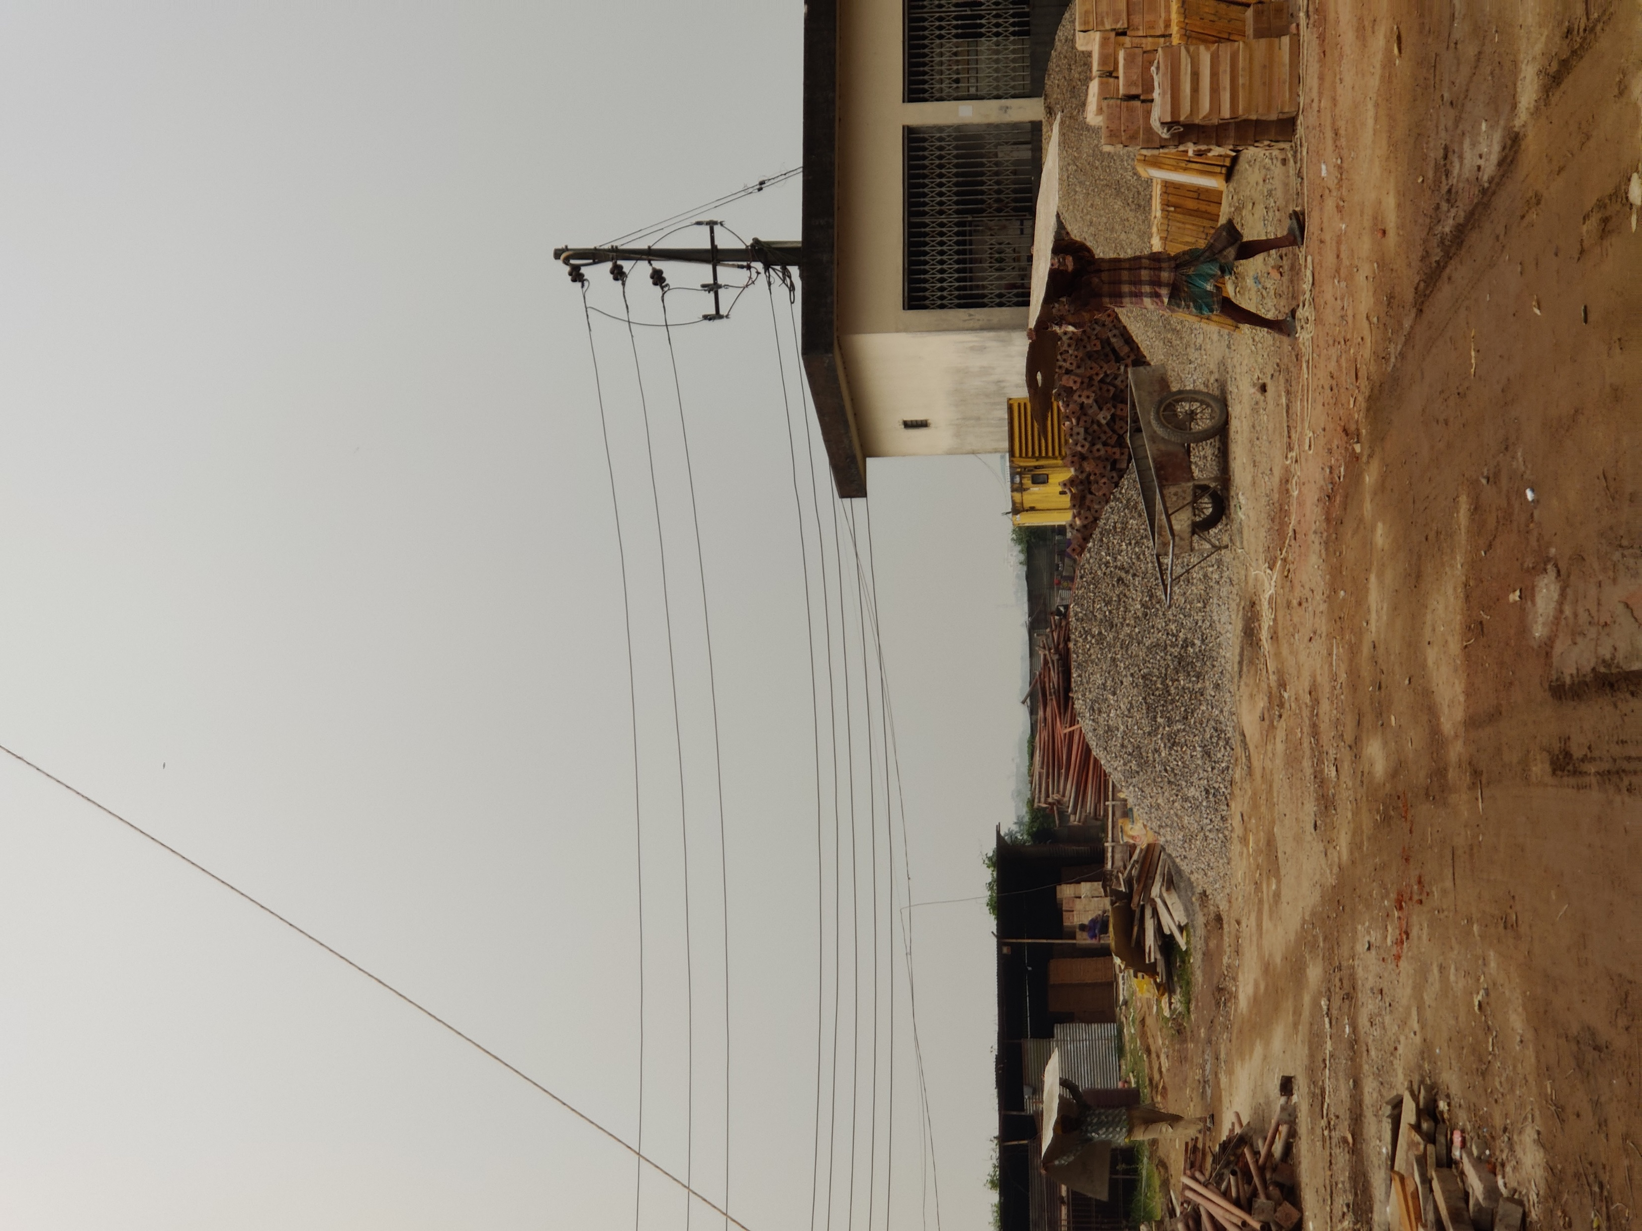

Slide 11
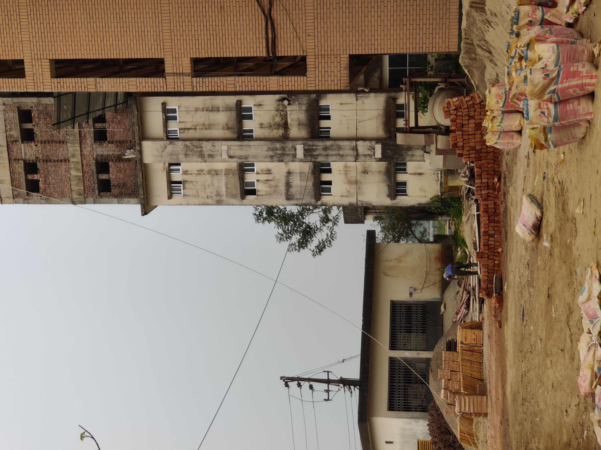

Slide 12
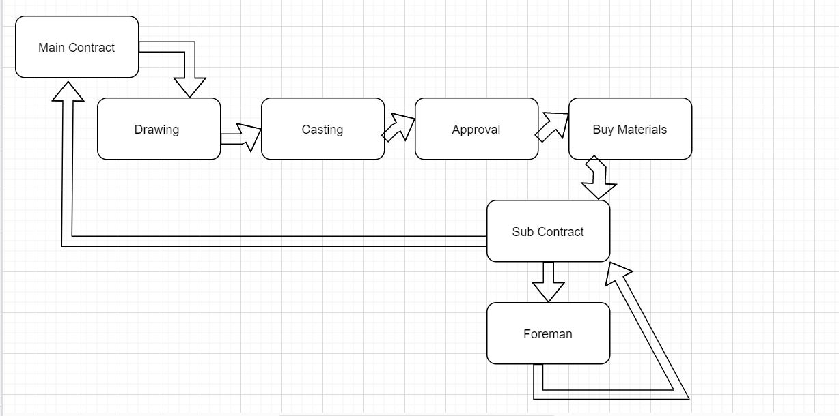
Work Flow :

Slide 13
Hopefully our construction site database management system will make it easier to run the whole process more efficiently .

Slide 14
Thank You

